Slide 1

PROMPT-A-THON 2026
BursaIQ
From Escalating Experts to Empowering Everyone in the Exchange
A conversational market-intelligence assistant that helps every Warga Bursa ask, understand and decide with confidence.
ASK
→
ANALYSE
→
ANSWER
→
ACT
Bursa Malaysia | July 2026
01 / 19

Slide 2




00 · THE TEAM
Three minds. One mission.
Different strengths, one shared direction — People behind BursaIQ.
01
02
03
Lim Kim Hoong
Abby Tiew Mei Qing
Pert Song Sow
GCMC · Age 27
GCMC · Age 28
GCMC · Age 32
BursaIQ · Prompt-a-thon 2026
02 / 19

Slide 3







01 · THE PROBLEM
One question. Five hidden steps.
A simple question triggers a multi-step retrieval chase and the answer often delays after the decision is made.
1
2
3
4
5
Find
→
Filter
→
Interpret
→
Reconcile
→
Validate
Locate the right dashboard or dataset
Set dates, segments and measures
Read multiple visuals and definitions
Compare views or consolidate data
Confirm the answer with an expert
Result: The answer may arrive after the moment of decision has already passed.
BursaIQ · Prompt-a-thon 2026
03 / 19

Slide 4


02 · THE EVIDENCE
The value is stored, not realised
The pattern holds worldwide, and the same gap is already measurable inside Bursa.
68%
70%
60%
of enterprise data is never used
goes unused for analytics
say half their data is “dark”
Source: Seagate, Rethink Data
Source: Forrester
Source: Splunk / IBM
THE SAME GAP, MEASURED INSIDE BURSA
20+
40
< 2h
50%
RM 50k
ad hoc data requests each month
staff-hours spent retrieving
average turnaround per request
involve data we already hold
annual productivity at stake
The gap: The data exists. The value does not. Half the effort is spent re-finding what Bursa already owns.
BursaIQ · Prompt-a-thon 2026
04 / 19

Slide 5







03 · REAL-WORLD EXAMPLES
The questions are simple. The retrieval path is not.
Questions that surface in management meetings, market reviews and time-sensitive discussions.
TRADING ACTIVITY
FUND FLOW
MARKET DRIVERS
Which investor group drove the recent decline in Average Daily Traded Value?
How does year-to-date fund flow compare with the same period last year?
Which sectors or stocks are driving yesterday’s market performance?
MARKET VELOCITY
IPO PERFORMANCE
ETF PERFORMANCE
How does month-to-date market velocity compare with last year?
How many companies listed on the Main, ACE and LEAP Markets this half?
Which ETFs recorded the highest growth in traded value and volume?
Today: Each of these can take several dashboards, manual comparisons and analyst validation before an answer exists.
BursaIQ · Prompt-a-thon 2026
05 / 19

Slide 6




04 · ADOPTION BARRIER
Access alone was never going to be enough
The dashboards exist. The data exists. Four human habits still stand between a person and an answer.
01
02
03
04
Coordination fatigue
Market literacy gap
Learning friction
Ownership avoidance
Every answer runs through somebody else. So the question quietly goes unasked.
A dashboard assumes a fluency in the market. Not everyone here had the same understanding.
Every dashboard has its own logic. Learning six is harder than asking one colleague.
Pull the number yourself and you own the number. Most would rather not carry it.
The real barrier: It was never access to the data. It is the effort, and the accountability, of using it.
BursaIQ · Prompt-a-thon 2026
06 / 19

Slide 7



05 · THE COST
Paid Twice: Once by the Person, Once by the Decision
The accessibility gap costs an employee their independence and costs the organization its speed.
TODAY · DEPENDENCY
WHAT IT COSTS THE ORGANISATION
Every answer runs through somebody else
Slower decisions
Questions stay open during the discussion that needed them
Waiting becomes normal, so questions go unasked
Meeting disruption
Teams pause, defer or schedule follow-up work
Specialists absorb work that is not their expertise
Analytical bottlenecks
Specialists on repeat retrieval, not analysis
WITH BursaIQ · SELF-RELIANCE
Inconsistent interpretation
Different filters produce conflicting answers
The person with the question reaches the answer
Asking costs nothing, so more gets asked
Reduced responsiveness
Slower reaction to market and stakeholder needs
Specialists return to analysis and judgement
Lower data return
Existing datasets deliver less than they could
Impact chain: Slower retrieval → Delayed insight → Deferred or less-informed decisions
BursaIQ · Prompt-a-thon 2026
07 / 19

Slide 8





THE PROPOSED SOLUTION
BursaIQ
Ask a Question. Get a Decision-ready Answer.
A secure natural-language intelligence layer that turns trusted internal data into accessible, visual and traceable insights.
ASK
ANALYZE
ANSWER
ACT
Everyday language — no dashboards or jargon
Interprets intent on governed data
Direct answer with context and source
Decide with confidence in the moment
08 / 19

Slide 9
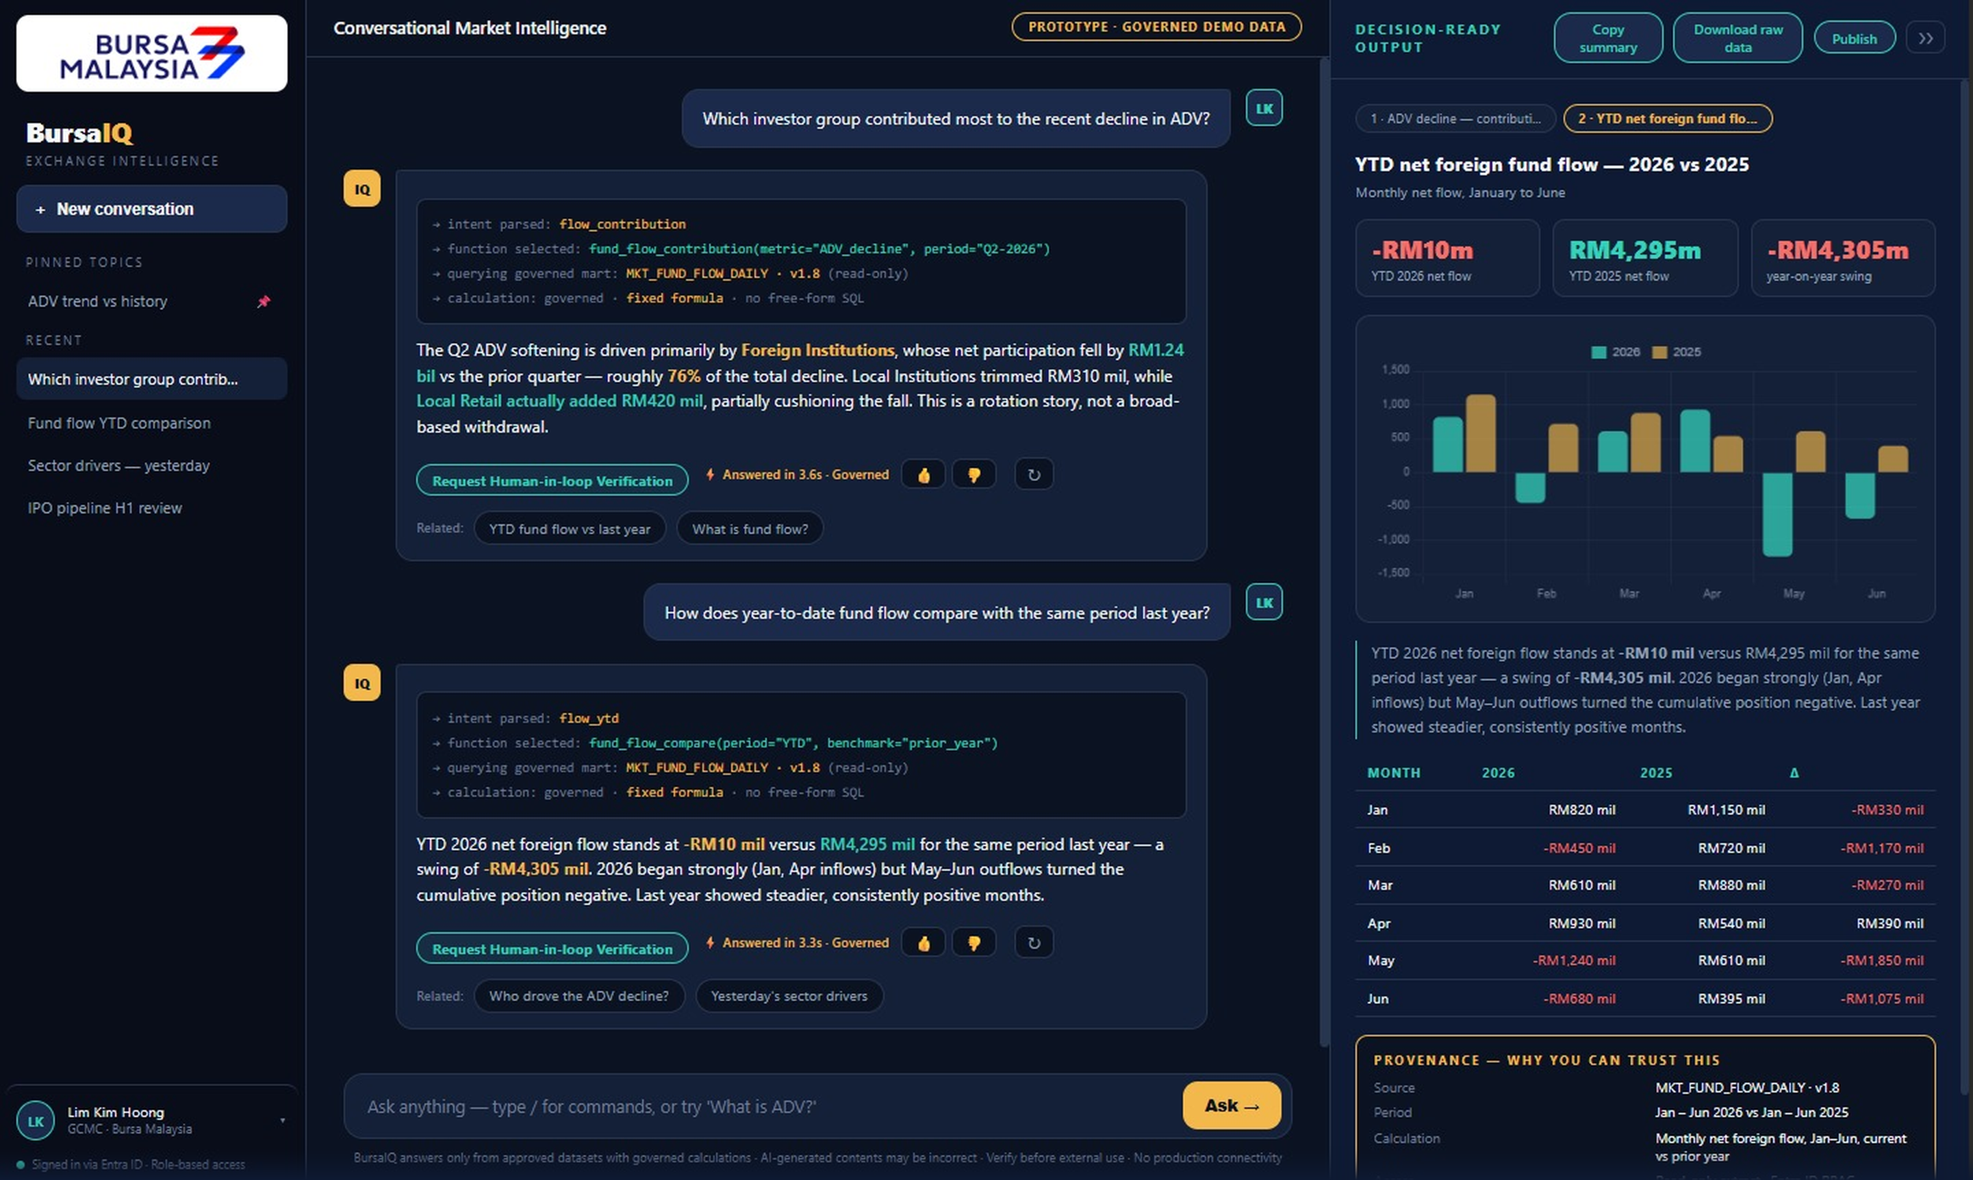
06 · THE PROTOTYPE
Not a concept. This is running today.
A real question, a real follow-up, answered from governed data with the working and the source shown.
01
Asked in plain language
No SQL, no dashboard, no need to know where the data lives.
02
Governed function call
A fixed formula against a read-only mart, versioned. No free-form SQL is ever written.
03
A real follow-up
The second question builds on the first. This is a conversation, not a search box.
04
Verifiable, and checkable
Provenance on every answer, plus one-click human verification for high-stakes questions.
Working prototype · Governed demo data · Answered in 3.6s with numbers and chart
Where we are: Built before the pitch, not promised after it. What you are seeing is the actual product, not a mockup.
BursaIQ · Prompt-a-thon 2026
09 / 19

Slide 10

07 · THE ARCHITECTURE
One Engine, Bursa IQ Engine, One Governed Path to Data
Every surface calls the same orchestration engine: The model reasons, the governed layer supplies the numbers.
LLM Providers
↕
AI Gateway
Web app
Azure OpenAI · Swappable models
↕
or
↔
BursaIQ
Entra ID
User
⇄
Microsoft Teams
Supervisor Agent
↔
Identity, role and entitlement
↓
Determine Intent Agents
↔
Azure AI Search
Download file
↙
Intent → Governed function → Result
Dataset and metric metadata
Excel, ready to use
↓
DATA SOURCES · READ-ONLY
↕ model calls
↔ data and identity, inside the tenant
DB 1
DB 2
DB 3
DB 4
Every answer ships with: Direct answer · Chart · Reporting period · Source dataset · Calculation used
BursaIQ · Prompt-a-thon 2026
10 / 19

Slide 11





08 · ACCURACY & ASSURANCE
From Accuracy to Accountability
A conversational layer is only worth having if the number it returns can be trusted in a board paper.
01
02
03
04
Governed calculation
Golden-answer testing
Regression testing
Human validation on request
The formula lives in the semantic layer. The model selects a function, it never writes free-form SQL, so the maths cannot drift.
Every metric has a known-correct result. Generated answers are compared against it before anything ships.
Historical questions are re-run before any prompt or model change, so accuracy drift is caught before users meet it.
For board-level questions, one click routes the answer to the data owner to confirm before it is used.
WHAT WE ARE NOT CLAIMING
Generative systems can be confidently wrong, and this one is no exception. That is precisely why the calculation is governed rather than generated, why every answer carries its source, and why a person can be put back in the loop on demand.
Standard: The model may phrase the answer. It never decides the number.
BursaIQ · Prompt-a-thon 2026
11 / 19

Slide 12



09 · ACCESS WITH BOUNDARIES
Everyone can ask. Not everyone can see.
BursaIQ widens who can ask a question. It never widens what a person is allowed to see.
01
02
03
04
User ask
We check who are them
Query inherits user’s rights
User see only their scope
One entry point for the whole organisation. No one needs to know where the data lives.
Entra ID resolves your identity, role and business unit before anything is retrieved.
Row and column entitlements are applied at query time, not filtered out afterwards.
The answer is built from data that the role already permits. Nothing else is reachable.
WHAT THAT MEANS IN PRACTICE
A market analyst asks about ADV
The same analyst asks about payroll
An HR partner asks about benefits take-up
Answered in full
No data returned
Answered, for their population only
Distinction: BursaIQ inherits user existing access. It is a faster way to reach what users are already entitled to, never a way around it.
BursaIQ · Prompt-a-thon 2026
12 / 19

Slide 13







10 · DOMAIN PACKS
Market data is where we start, not where it stops
The same governed engine can serve any approved domain, so value reaches every function rather than a single desk.
MARKET & TRADING
IN SCOPE
LISTING & ISSUER
IN SCOPE
STRATEGY & COMMS
Market Intelligence
Issuer Insight
Planning & Narrative
ADV, velocity, fund flow, IPO pipeline, ETF performance
Listing pipeline, filings status, issuer profiles and disclosures
Peer benchmarks, market share and the numbers behind stakeholder communications
FINANCE & CORPORATE
RISK & COMPLIANCE
HUMAN RESOURCES
Cost & Performance
Oversight & Surveillance
People & Workforce
Budgets, cost centres and spend against plan
Trend monitoring, unusual-activity context and case background
Identity and org structure, applicant tracking, benefits administration
The principle: One way to ask. Many governed domains behind it. Every department served by the same engine.
BursaIQ · Prompt-a-thon 2026
13 / 19

Slide 14







11 · THE COLLABORATORS
Works if only the data owners are in the room
BursaIQ is not one team’s project. Every governed domain has an owner, and each of them makes the layer possible.
THE CORE
Market Operations
Human Resources
Defines and validates the market metrics
Sets the scope and entitlements for people data
Group Technology &
Data and Digital Services
Finance
Risk & Compliance
Confirms figures and definitions carry across reporting
Sets the guardrails and reviews what may be asked
Owns the databases, the pipelines and the platform every answer depends on. Without their data marts and access model there is no governed layer to ask questions of.
Security & Identity
Data Governance
Owns the Entra ID roles the access model runs on
Approves every definition before it enters the layer
What we are asking for: Not budget, and not headcount. Access to the data you already own, and a definition we can all agree on.
BursaIQ · Prompt-a-thon 2026
14 / 19

Slide 15
12 · STAND OUT POINTS
BursaIQ vs other Tools: Key Differentiators
Delivering Up-to-date Exchange Intelligence for Faster and Smarter Decisions
Traditional AI Chatbots
Business Intelligence Tools
BursaIQ
Data Retrieval
✕
Static knowledge
⚠
Requires manual refresh
✓
Queries up-to-date data
Self-Quary Agents
✕
Manual inputs required
✕
Predefined dashboards
✓
Metadata search and context retrieval
NLP
✓
General responses
✕
Requires SQL or UI navigation
✓
Context-aware, Bursa-specific NLP
Security & Access
⚠
Limited access control
✓
Enterprise-grade RBAC
✓
Fine-grained, role-based security
Bursa-Specific Tuning
✕
Generic AI responses
⚠
Requires configuration
✓
Deep understanding of Bursa terms
Seamless Teams Integration
✕
Requires custom setup
✕
Not natively integrated
✓
Fully embedded in Teams workflow
BursaIQ combines the simplicity of AI chat, analytical power of BI platforms and enterprise-grade security at scale
BursaIQ · Prompt-a-thon 2026
15 / 19

Slide 16




13 · THE VALUE
What it costs, what it returns, and when it pays back
Validated internal baselines on one side, a contained build on the other.
THE RETURN · PER YEAR
THE INVESTMENT · TO PILOT
3h → 15m
70%
~12 weeks
3 people
average answer time
of ad hoc requests automated
proof of concept to pilot
part-time, no new headcount
40 hrs
RM 50k
Existing
4 marts
analyst time redirected / month
annual productivity value
Azure estate and licences
read-only, already built
WHERE THE VALUE LANDS
Productivity
Decision-making
Capability
Cut retrieval and formatting effort · Fewer repetitive ad hoc requests · Redirect analysts to higher-value work
Answer questions during meetings · Reduce follow-up delays · Improve consistency and confidence
Broaden self-service access · Raise data and market literacy · Scale conversational analytics
Payback: The pilot pays for itself inside the first year on redirected analyst time alone, before any decision-quality gain is counted.
BursaIQ · Prompt-a-thon 2026
16 / 19

Slide 17




14 · OPPORTUNITY & RISK
A large upside, with every risk named and controlled
What BursaIQ unlocks if it works, and what stands in the way if it is built carelessly.
THE OPPORTUNITY
PRINCIPAL RISKS · AND THE CONTROL
ANTICIPATE
Production and data-security exposure
HIGH
Insight arrives before the question is asked
✓ Read-only. Isolated from live trading systems.
ADVISE
Inaccurate or misleading AI answers
HIGH
Understanding at every level and in every language
✓ Governed functions only. The model never writes the formula.
AUTOMATE
Data governance and access complexity
MED
Answers become finished, formatted work
✓ Role-based access and entitlement checks at query time.
AMPLIFY
Low adoption or limited relevance
HIGH
One answer lifts the whole organisation
✓ Designed around the four adoption barriers, not around the data.
Key gate: No production connectivity and no autonomous decisions until the security, accuracy and governance gates are passed.
BursaIQ · Prompt-a-thon 2026
17 / 19

Slide 18




15 · THE ROADMAP
Scale only when Evidence supports the next stage
A phased approach limits exposure, produces measurable learning and keeps management in control of each expansion.
01
02
03
04
Proof of Concept
→
Controlled Pilot
→
Governed Expansion
→
Enterprise Scale
One team, non-sensitive sample data
Real users, read-only, human validation
Role-based access across approved domains
Monitored service, continuous improvement
Gate: known-answer accuracy & security review
Gate: adoption, response quality & latency
Gate: governance approval & support readiness
Gate: service levels & sustained value
What we are asking for: Approval to run Stage 01, one team, one read-only mart, and a named data owner per domain
BursaIQ · Prompt-a-thon 2026
18 / 19

Slide 19





THE NEXT HORIZON
Intelligent Exchange
From Answering to Anticipating.
BursaIQ: Bold in Innovation, United in Purpose, Responsible by Design, Strengthened through Synergy and Agile in Every Decision
ANTICIPATE
ADVISE
AUTOMATE
AMPLIFY
Insight arrives before the question
Understanding at every level and language
Answers become finished, formatted report
One answer lifts the whole organisation
19 / 19

